Slide 1

B Tech Project
Topic: Development of a C# .NET application to determine Slope Stability using Spencer’s Limit Equilibrium method.
Developer:
Virendra Satish Naik,
Roll No. 18155084,
BTech Part-IV,
Department of Mining Engineering,
IIT(BHU), Varanasi.
Project Supervisor:
Dr. Ashok Jaiswal,
Associate Professor,
Department of Mining Engineering.
IIT(BHU) Varanasi.

Slide 2
Acknowledgements:
In the successful accomplishment of this project, many people have bestowed on me their blessings and their best support, I would like to utilize this moment to thank all the people who have been concerned with this project.
Firstly, I would like to express my deep gratitude to Dr. Ashok Jaiswal, my research supervisor, for his patient guidance, enthusiastic encouragement and useful critiques of this project work even at the time of this global pandemic (Covid19) through virtual meetings and telephonic conversations.
My gratitude is also extended to my college senior Mr. Rajat Khandelwal and friend cum colleague Mr. Ritesh Kumar for their timely help and guidance required during the course of this project.
Finally, I wish to thank my parents Mr. Satish Naik and the kindest Mrs. Lolakshi Naik, my brother Mr. Tejas Naik and my friends for providing the support and encouragement without which the progress of my study could’ve been a lot tougher.

Slide 3
Contents:
Introduction
Objective of the project
Limit Equilibrium Methods
Spencer’s Limit Equilibrium Method
Approach for the program.
How to create a plug-in for AutoCAD using C# .NET
Creating windows form to take user inputs
Procedure to develop the required code
Example images
Improvisations and optimisations
Summary

Slide 4
Introduction:
Slope stability analysis is performed to assess the safe design of a human-made or natural slopes (e.g. embankments, road cuts, open-pit mining, excavations, landfills etc.) and the equilibrium conditions. Slope stability is the resistance of inclined surface to failure by sliding or collapsing.
If the forces available to resist movement of a section are greater than the forces driving movement, the slope is considered stable. A factor of safety is calculated by dividing the forces resisting movement by the forces driving movement. The factor of safety is the measure for the stability of a slope.
Limit equilibrium analysis: Most slope stability analysis computer programs are based on the limit equilibrium concept for a two- or three-dimensional model. Two-dimensional sections are analyzed assuming plane strain conditions. Stability analyses of two-dimensional slope geometries using simple analytical approaches can provide important insights into the initial design and risk assessment of slopes.
Limit equilibrium methods investigate the equilibrium of a soil mass tending to slide down under the
influence of gravity. Translational or rotational movement is considered on an assumed or known potential slip
surface below the soil or rock mass. There are various methods developed for analysis of slope stability using
Limit Equilibrium technique.
Spencer’s Limit Equilibrium Method:
Spencer's Method of analysis requires a computer program capable of cyclic algorithms, but makes
slope stability analysis easier. Spencer's algorithm satisfies all equilibria (horizontal, vertical and driving
moment) on each slice. The method allows for unconstrained slip plains and can therefore determine the
factor of safety along any slip surface. The rigid equilibrium and unconstrained slip surface result in more
precise safety factors than, for example, Bishop's Method or the Ordinary Method of Slices.

Slide 5
2) Objective of the project:
To develop a computer program to implement the Spencer’s Limit Equilibrium Method of Slope Stability Analysis.
Creation of a plug-in for AutoCAD which would provide the user a form to input various slope, test case, soil parameters, provide various buttons to carry out operations on the data input and would also contain read-only-textboxes to display required output.
The form would be displayed when the user loads the ‘.dll’ project file over AutoCAD and runs the command method.
Creation of Windows Forms Library application to display the form to the user, program the form, read and process the input.
The program would display the slope, the test curve, the slices for the test case and the curve with the lowest factor of safety in the region on AutoCAD. It should also display the factor of safety for the test curve and the minimum factor of safety in the region in textboxes in the given form. Factor of safety for various curves are calculated using Spencer’s Limit Equilibrium method.

Slide 6
3) Limit equilibrium methods :
Limit equilibrium methods investigate the equilibrium of a soil mass tending to slide down under the influence of gravity. Translational or rotational movement is considered on an assumed or known potential slip surface below the soil or rock mass. In rock slope engineering, methods may be highly significant to simple block failure along distinct discontinuities. All these methods are based on the comparison of forces, moments, or stresses resisting movement of the mass with those that can cause unstable motion (disturbing forces). The output of the analysis is a factor of safety, defined as the ratio of the shear strength (or, alternatively, an equivalent measure of shear resistance or capacity) to the shear stress (or other equivalent measure) required for equilibrium. If the value of factor of safety is less than 1.0, the slope is unstable.
In the method of slices, also called OMS or the Fellenius method, the sliding mass above the failure surface is divided into a number of slices. The forces acting on each slice are obtained by considering the mechanical (force and moment) equilibrium for the slices. Each slice is considered on its own and interactions between slices are neglected because the resultant forces are parallel to the base of each slice. However, Newton's third law is not satisfied by this method because, in general, the resultants on the left and right of a slice do not have the same magnitude and are not collinear. Various methods were hence developed to reduce the assumptions made in OMS and increase the accuracy in the calculation of FOS.
The various methods are still not barred of assumptions to simplify the rigorous equations and calculations. The bishop method assumes the inter-slices forces to be horizontal and the shear forces between the slices are neglected. Going a step ahead, Spencer developed a method taking into consideration the shear forces between the slices as well. The assumption used by Spencer was that the resultant inter-slice forces have a constant inclination throughout the sliding mass.

Slide 7
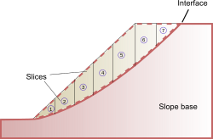
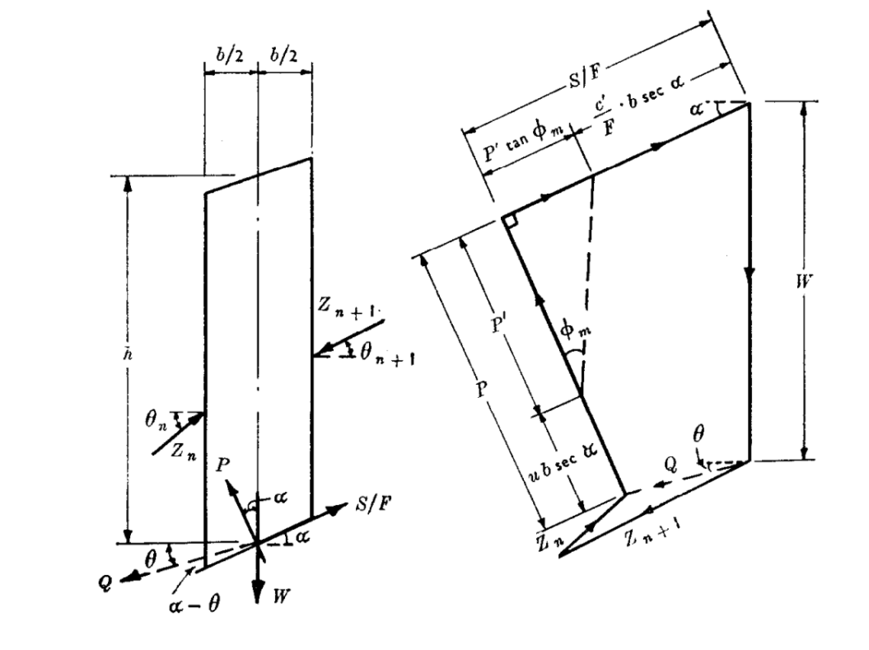
4) Spencer’s Limit Equilibrium method:
Being a method derived from the ordinary method of slices, this method starts with the division of the sliding rock mass into a number of slices. It requires a satisfying equilibrium of forces and moments acting on individual blocks.
The division of the sliding mass into slices, free body diagram of a slice are shown in the figures below.
The five forces can be described as follows :
(a) the weight (W);
(b) the total reaction (P) normal to the base of the slice; this force will have two components:
(i) the force (P’) due to the effective or inter-granular stress ;
(ii) the force (u b Sec α) due to the pore pressure (u) ;
(c) the mobilized shear force (S_{m} = S/F),
(d) the inter-slice forces (Z_{n}) and (Z_{n+1}); for equilibrium, the resultant (Q) of these two forces must pass through the point of intersection of the three other forces.

Slide 8
4) Spencer’s Limit Equilibrium Method (Contd.)
The descriptions of other terms in the figure are as follows:
(a) α = Slope of base of the slice,
(b) β = Slope of embankment,
(c) b = width of slice, h = average height of the slice,
(d) θ_{n} and θ_{n+1} are the inclinations of forces Z_{n} and Z_{n+1} respectively with x axis,
(e) θ is the inclination of Q with x axis.
(f) c’ = cohesion in soil, φ’ = internal angle of friction of soil.
Initially, the total disturbing and resisting forces are calculated neglecting the inter-slice forces and factor of safety is calculated using these values using the relation:
F = S / S_{m} . . . . . . . . . . . . . . . (1)
where, S = total shear strength along the slip surface,
S_{m} = mobilized shear stress.
The other equations representing the relation between the afore mentioned forces are as follows:
(a) P = P’ + u b Sec α . . . . . . . . . . . . . . . (2)
(b) S=c b Sec α + P’ tan φ’,
(c) ∴ S_{m} = (c b Sec α + P’ tan φ’) / F . . . . . . . . . . (3)
F can be calculated as follows, neglecting the inter-slice forces:
F = Σ[c’ b Sec α + tan φ’ (W Cos α - u b Sec α)] / Σ(W Sin α) . . . . . (4)
The actual factor of safety when inter-slice forces are considered is generally in the range of F - 1.35 F
So, the initial value for iteration is set at F and we iterate up to 1.35 F with a suitable gradient.

Slide 9
4) Spencer’s Limit Equilibrium Method (Contd.)
By resolving normal and parallel to the base of the slice the five forces shown in the free body diagram the following expression is obtained for the resultant (Q) of the two inter-slice forces acting on a slice:
Q = [c’ b Sec α / F + tan φ’ (W Cos α - u b Sec α) / F – W Sin α] / [Cos(α - θ) ( 1 + tan φ’ tan(α - θ) /F)]
Now if the external forces on the embankment are in equilibrium, the vectorial sum of the inter-slice forces must be zero. In other words, the sum of the horizontal components of the inter-slice forces must be zero and the sum of their vertical components must also be zero, i.e.
Σ(Q Cos θ) = 0 . . . . . . . . . . (5)
and, Σ(Q Sin θ) = 0 . . . . . . . . . . (6)
Since the inclinations of Q for each slice is considered to be equal for this method, θ, Cos θ and Sin θ are the
same for each slice and hence they can be removed out of the summation and the condition becomes:
ΣQ = 0 . . . . . . . . . . (7)
Furthermore, if the sum of the moments of the external forces about the center of rotation is zero, the sum of the moments of the inter-slice forces about the center of rotation must also be zero:
Σ(Q R Cos(α - θ)) = 0
And since the slip surface is assumed to be circular, the radius of curvature (R) is constant and the condition
becomes: Σ(Q Cos(α - θ)) = 0 . . . . . . . . (8)
Values of F and of θ must be found which satisfy the equations (7) and (8) and it must be noted that although, for a given slice, the value of 0 will be the same in each equation, the inter-slice forces will not necessarily be parallel throughout.

Slide 10
5) Approach for the program:
Firstly, we have to add references for the AutoCAD features to C# .NET application to access the required AutoCAD applications, databases, geometric and graphic functions.
After setting up the .NET application of type windows forms library (which gives access to windows forms as well as class library), we will create a form to be displayed before the user to get input and print the numeric outputs.
The input we require are the slope parameters (Start point, bench height and width, slope of embankment), test case parameters (distance of point on arc cutting the upper bench from the crest and that of the point on arc cutting the lower bench from the toe, the radius of test arc and the number of slices) and the soil parameters (bulk density of soil, cohesion, internal angle of friction of soil).
These parameters will be input by the user through textboxes in the form and we need to provide the user
with a set of buttons to commit actions such as drawing the slope, the slices for the test case and get the FOS
for the test case and the minimum FOS in the region into the textboxes.
After getting the required inputs, we need to write codes for the various buttons to operate as per requirement.
We will create a function to draw the slope on the AutoCAD file, a function to draw the slices (functions to get the curve data and the slice points’ data would be written separately as they would be called a number of times while calculating the minimum FOS in the region), a function to calculate and return the FOS if the distances of end points of test circles and radius are input to it will be written and called repeatedly as well. Finally we will write code for a function which would iterate over a number of values for the distances and radius of test circles and calculate the minimum FOS by making repeated calls to the required functions, this function will also draw the line with the minimum FOS on AutoCAD.
For the sake of simplicity, we will consider the soil to be homogeneous and neglect the external forces and the pore pressure to begin with.

Slide 11
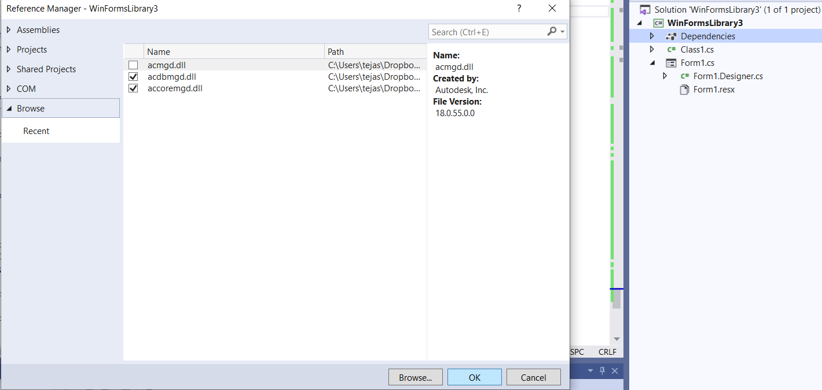
6) How to create a plug in for AutoCAD using C# .NET application:
As per our requirement, we need to open a new project with the Windows Forms Library template in Visual Studio. This project file and the solution file can be saved with the same name with .dll extension which would be loaded to AutoCAD. The project file will by default have a class with the name same as the project file name.
Once the project file opens, we need to add references to AutoCAD features and applications. Follow the given steps for this:
(a) Click on ‘View’ on the menu bar and click on ‘Solution Explorer’ to view the solution explorer if its not
already open.
(b) Click on the class name in the solution explorer and right click on ‘dependencies’.
(c) Click on add project reference and browse for the required references if they aren’t already available.
(d) The references we require are ‘acdbmgd.dll’ and ‘accoremgd.dll’. These need to be downloaded if not already available after setting up the applications.
(e) Click on the checkbox to select the references and
click on “OK” to finish the process.
(f) After adding the references, select both the references from the solution explorer, right click
and click on properties. Set the copy local to ‘NO’.

Slide 12
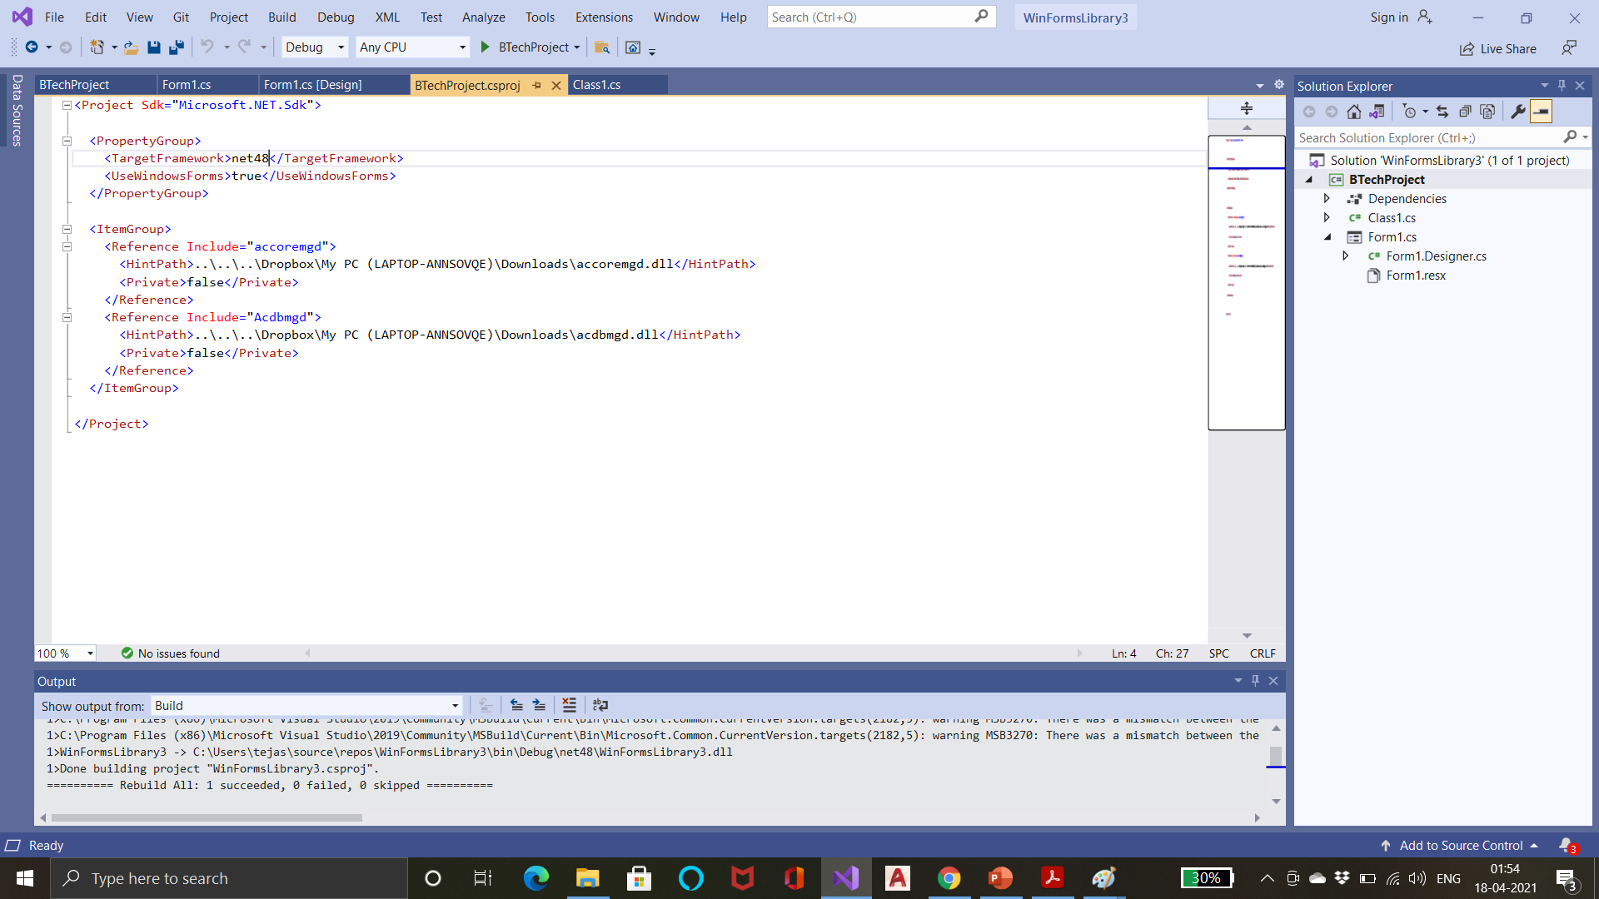
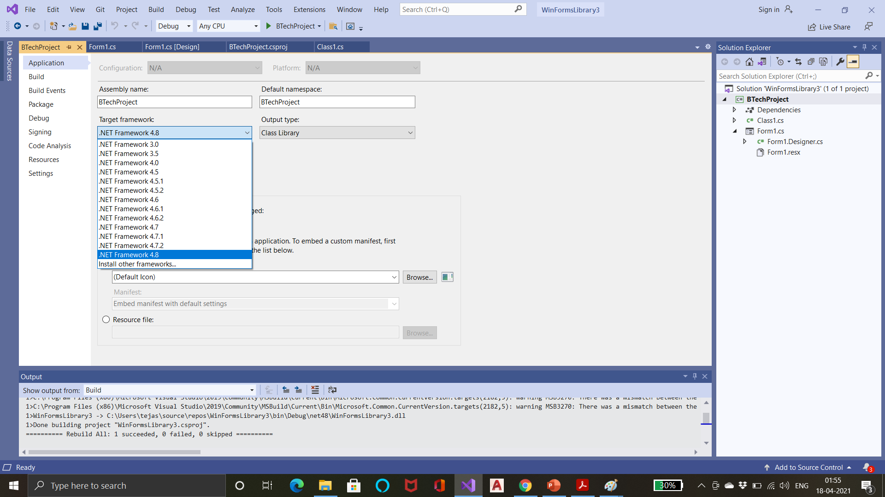
6) How to create a plug in for AutoCAD using C# .NET application (Contd.):
Since AutoCAD 2020 targets .NET framework 4.8 we need to set the target framework of the project if it’s set to some other framework by default. To do this, follow the following steps:
(a) Click on ‘Project’ in the menu bar and click on ‘class_name properties’ and replace the default framework keyword by net48.
(b) Restart the project file.
(c) Right click on the class name in the solution explorer and click on ‘properties’ and set the target framework to .NET version 4.8
With this, we are ready to start working on our project, having set up the file.

Slide 13
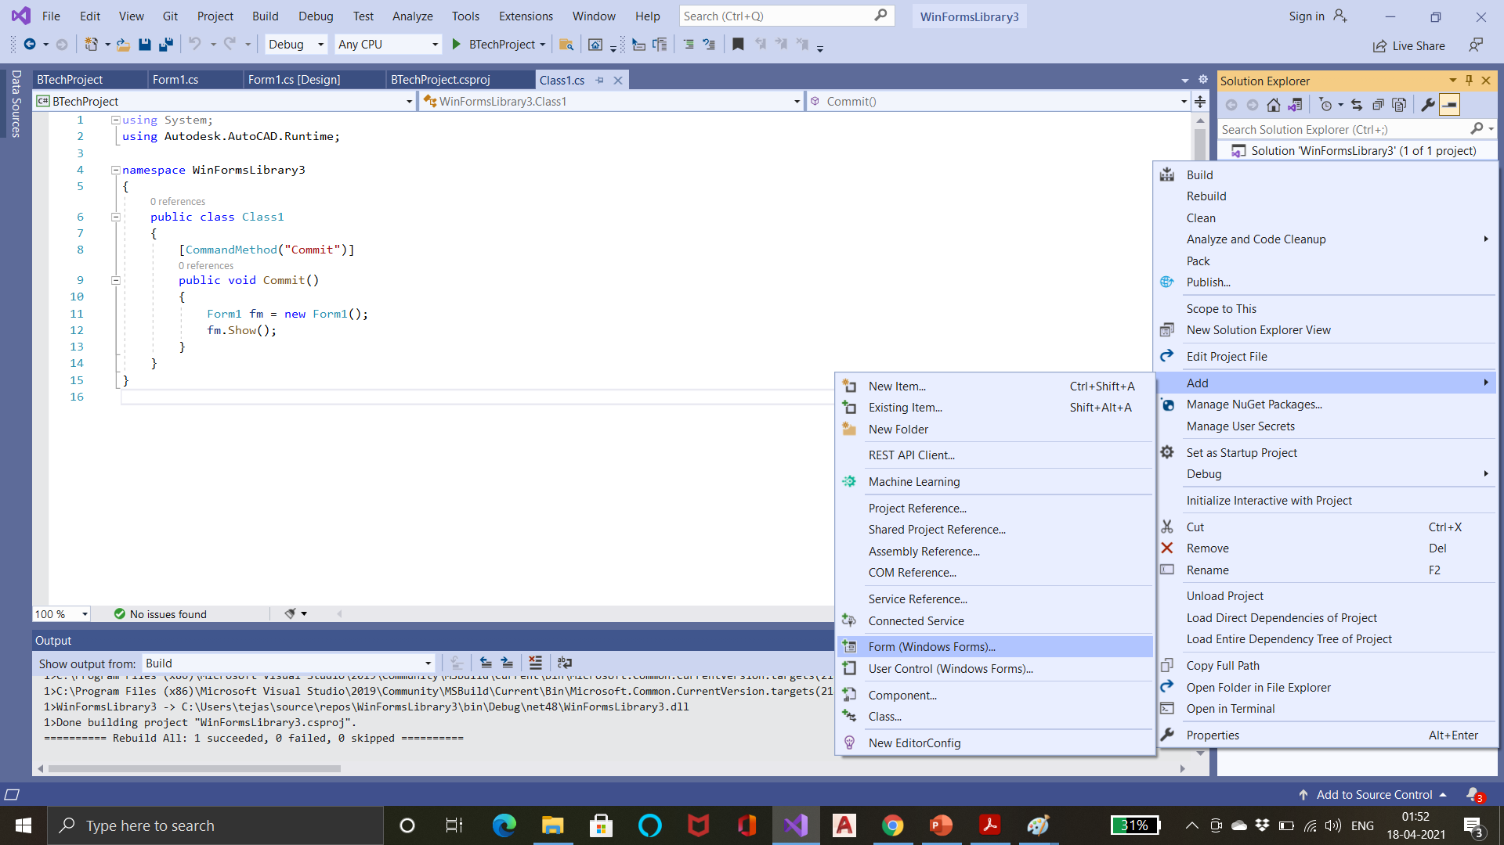
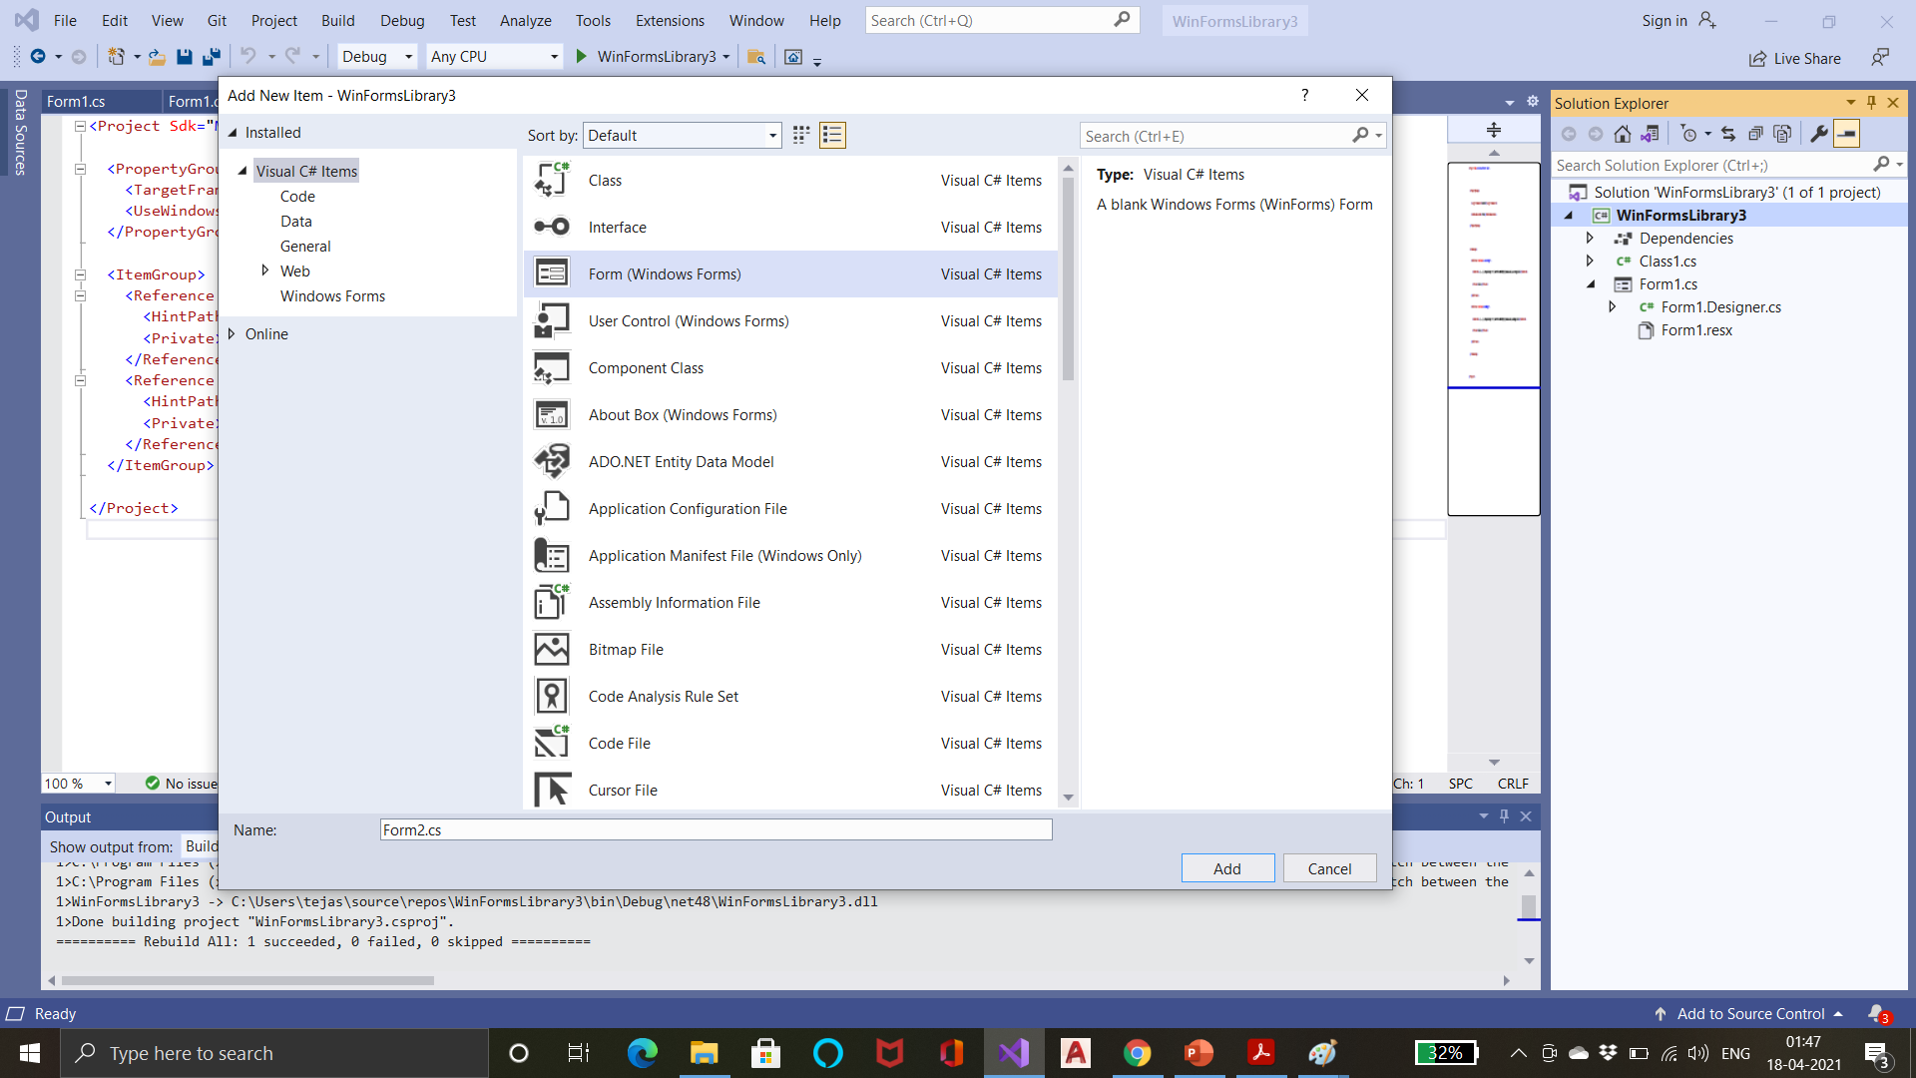
7) Creating Windows Form to take user inputs:
Right click on the class name in the solution explorer and hover the mouse over ‘Add’ option. Click on ‘Form (Windows Forms)’ from the drop down.
Select ‘Form ( Window Form)’ from the window which appears and then click on ‘Add’ after setting the name you wish, to the form.
The form will be added to your project file.

Slide 14
7) Creating Windows Form to take user inputs:
Once the file is open, we need to open the toolbox if it’s not already displayed. For that, click on ‘View’ in the menu bar and click on ‘Toolbox’ to open the toolbox.
Since we need to get three sets of inputs for slope, testcase, soil parameters respectively, we can add three group box each of which will contain one type of the parameters.
Change the text for the 3 group boxes, Slope parameters, Soil parameters and Test case parameters respectively by right clicking on the group boxes to open properties. The names can be changed as well.
Add 4 labels and 4 text boxes inside the 1st group box, 3 sets of labels and text boxes inside the 2nd and 4 sets in the 3rd group boxes.
Make required changes in the texts and names of the labels and the names of the textboxes to make them represent the parameter we want them to represent. Set ‘read-only’ to ‘False’ for all these textboxes.
Add 4 buttons to the form; one to draw slope, one to draw the test curve and the slices within the rock mass of the test curve, one to calculate the FOS of the test curve and one to display the curve with the minimum FOS and the minimum FOS value in the region. Set suitable texts and names for these buttons.
Next, we need to add two more textboxes; one to display the FOS value along the curve given by the user and another to display the minimum FOS value in the region. Set ‘read-only’ property for these textboxes to ‘True’ as we don’t require the user to input any value in these boxes.
Following slide contains an example how the form should look.

Slide 15
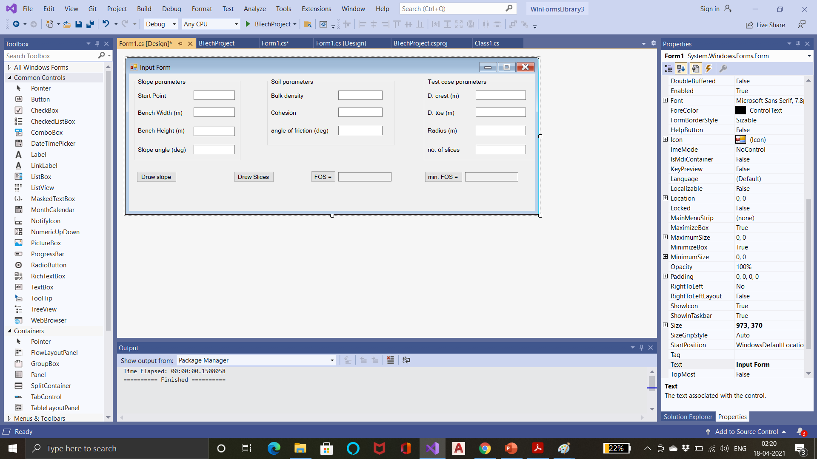
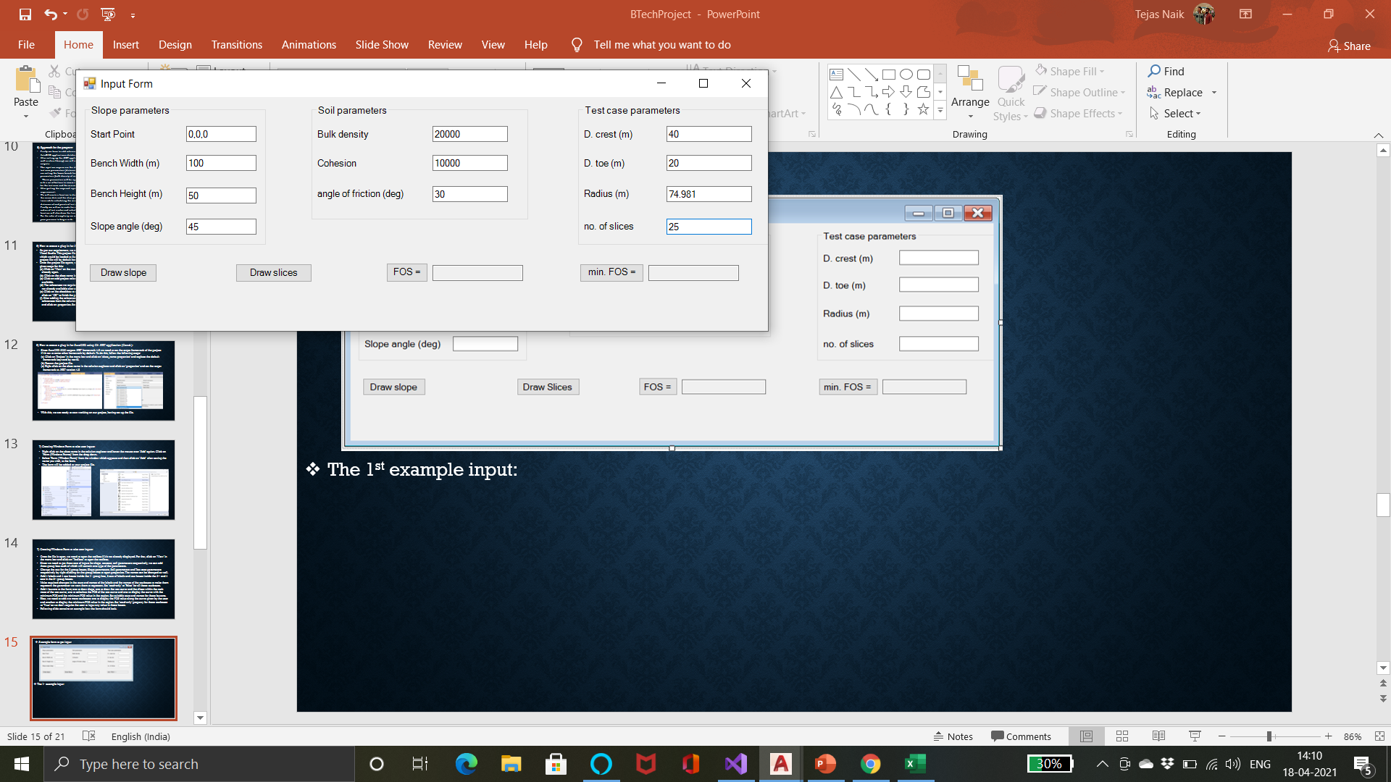
A sample form to get input:
The 1st example input:
The entire form need not be created or filled right at the beginning. We can proceed step by step starting with taking just slope parameters and drawing the slope and then building further.
Even if the entire form is built, partial outputs can be checked and the program runs just fine.

Slide 16
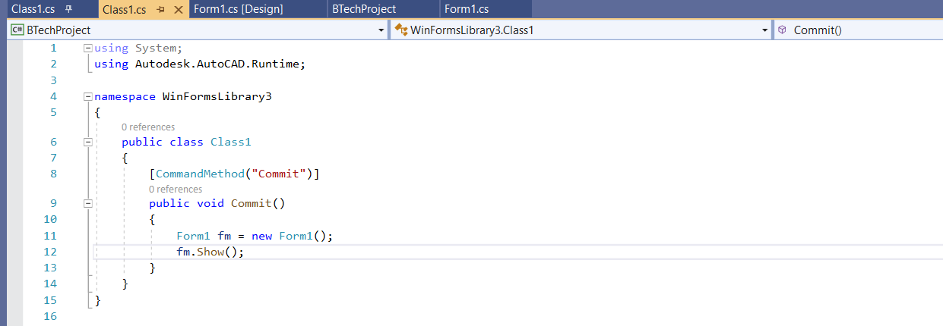
Procedure to display the form on AutoCAD:
For the form to be displayed on running a command method, we need to access the ‘runtime’ namespace from AutoDesk.AutoCAD.
To do this we add the line ‘using Autodesk.AutoCAD.Runtime;’ in the class library.
Next, we need to create a command method to run on AutoCAD. For this, type [CommandMethod(“method_name”)] inside the main class in the class library. The name I used for the method is “Commit”, this name will be typed in the Command prompt in AutoCAD to run the program.
Create a function for the Command method by typing:
public void method_name() { }
This method should contain the code to display the form when the method is run. The steps for this are as follows:
(a) Create an object of the form: // form_name object_name = new form_name();
(b) type // object_name.show(); to display the form.
The code is shown in the figure:

Slide 17
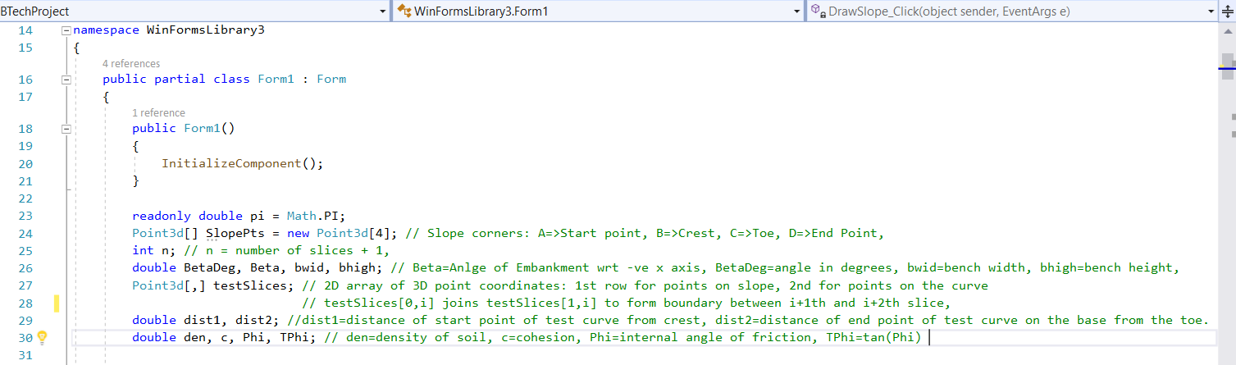
8) Procedure to develop the code:
We can open the class for the form by right clicking on the code and clicking on ‘View Code’. Coding
for the form can be started now.
Firstly, we need to add a few namespaces to access the required Documents, databases, drawing features from AutoCAD.
These namespaces can be added by writing the following lines in the form class under the given namespaces:
(a) using Autodesk.AutoCAD.ApplicationServices;
(b) using Autodesk.AutoCAD.DatabaseServices;
(c) using Autodesk.AutoCAD.Geometry;
We can start by declaring the variables we need to use in multiple functions globally. We can add variables to this area as and when we require. The variable I declared globally with their description can be seen in the figure below:

Slide 18
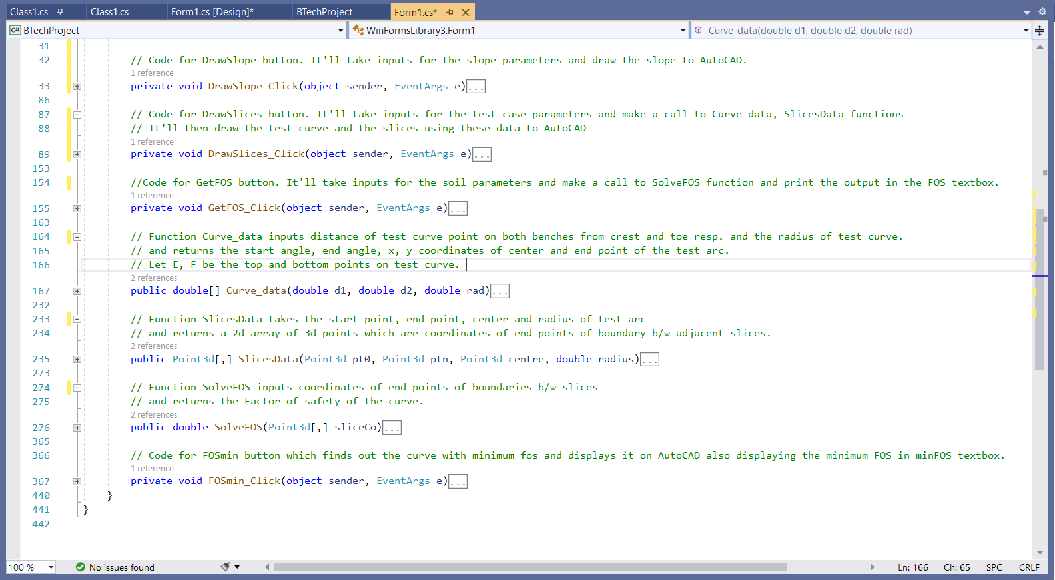
8) Contd.
The body of program is as shown in the figure. It contains the code for the 4 buttons and the different methods used.
The purpose of various functions are mentioned in the comments preceding the methods.

Slide 19
8) Contd. :
General codes/syntax to implement certain tasks
To display output on AutoCAD:
When a method needs to display a figure to an AutoCAD document, it needs to get access to a document, database, block table, block table record in AutoCAD and commit a transaction with AutoCAD.
Database is a part of the document, transaction is a part of database and block table, block table record are objects in a transaction. The code to access these things are as follows:
Document doc=Autodesk.AutoCAD.ApplicationServices.Core.Application.DocumentManager.MdiActiveDocument;
Database db = doc.Database;
doc.LockDocument();
using (Transaction trans = db.TransactionManager.StartTransaction()) {
BlockTable bt = (BlockTable)trans.GetObject(db.BlockTableId, OpenMode.ForRead);
BlockTableRecord btr = (BlockTableRecord)trans.GetObject(bt[BlockTableRecord.ModelSpace], OpenMode.ForWrite);
trans.Commit(); }
To make a geometric object:
We need to create a new object for whatever shape we need to draw using the code:
objectType object_name = new objectType();
Properties and parameters of these objects can be set using following syntax after declaring the object:
{ propertyType = propertyValue,};
- eg.: Line ln = new Line() {
{ ln.StartPoint = new Point3d(0, 10, 20),
ln.EndPoint = new Point3d(30, 40, 30),
ln.ColorIndex = 2, //for yellow colour, };
This object needs to be appended to Block table record and added to the transaction before the transaction is committed:
btr.AppendEntity(ln);
trans.AddNewlyCreatedObject(ln, True);

Slide 20
General syntax to implement certain tasks:
To read inputs from textbox:
Textboxes store values as strings, while we need to use most values in double or integer forms. So, we need to typecast them to the required form while reading form the textbox.
eg: double angle = Convert.ToDouble(Angle.Text);
This line stores the attribute in the Angle textbox in the angle variable in the double form.
We can further manipulate the values of attributes the way we want.
eg: the coordinate of a point (10,10,10) will be stored in the string form “10,10,10” while we want to store it
in the form of a 3d point. So, we can convert this string into a string array of the x, y and z coordinates of the point
as follows:
- string s = StartPoint.Text;
- string[] temp = s.Split(“,”);
- double x = Convert.ToDouble(temp[0]);
- double y = Convert.ToDouble(temp[1]);
- double z = Convert.ToDouble(temp[2]);
- Point3d StrPt = new Point3d(x, y, z);
This code inputs the attribute in the StartPoint textbox in the form of a string. The 2nd line builds an
array of strings by splitting the main string when a comma(,) is encountered. These string values can be
converted and stored in double type variables and then assigned to a Point3d type object.
To print output to textbox:
Since textboxes store values in the form of strings, the values to be printed need to be type-casted to strings if they are stored in some other form as follows:
- FOS.Text = Convert.ToString(F);
This line prints the value of variable F to the textbox FOS in the form of string.

Slide 21
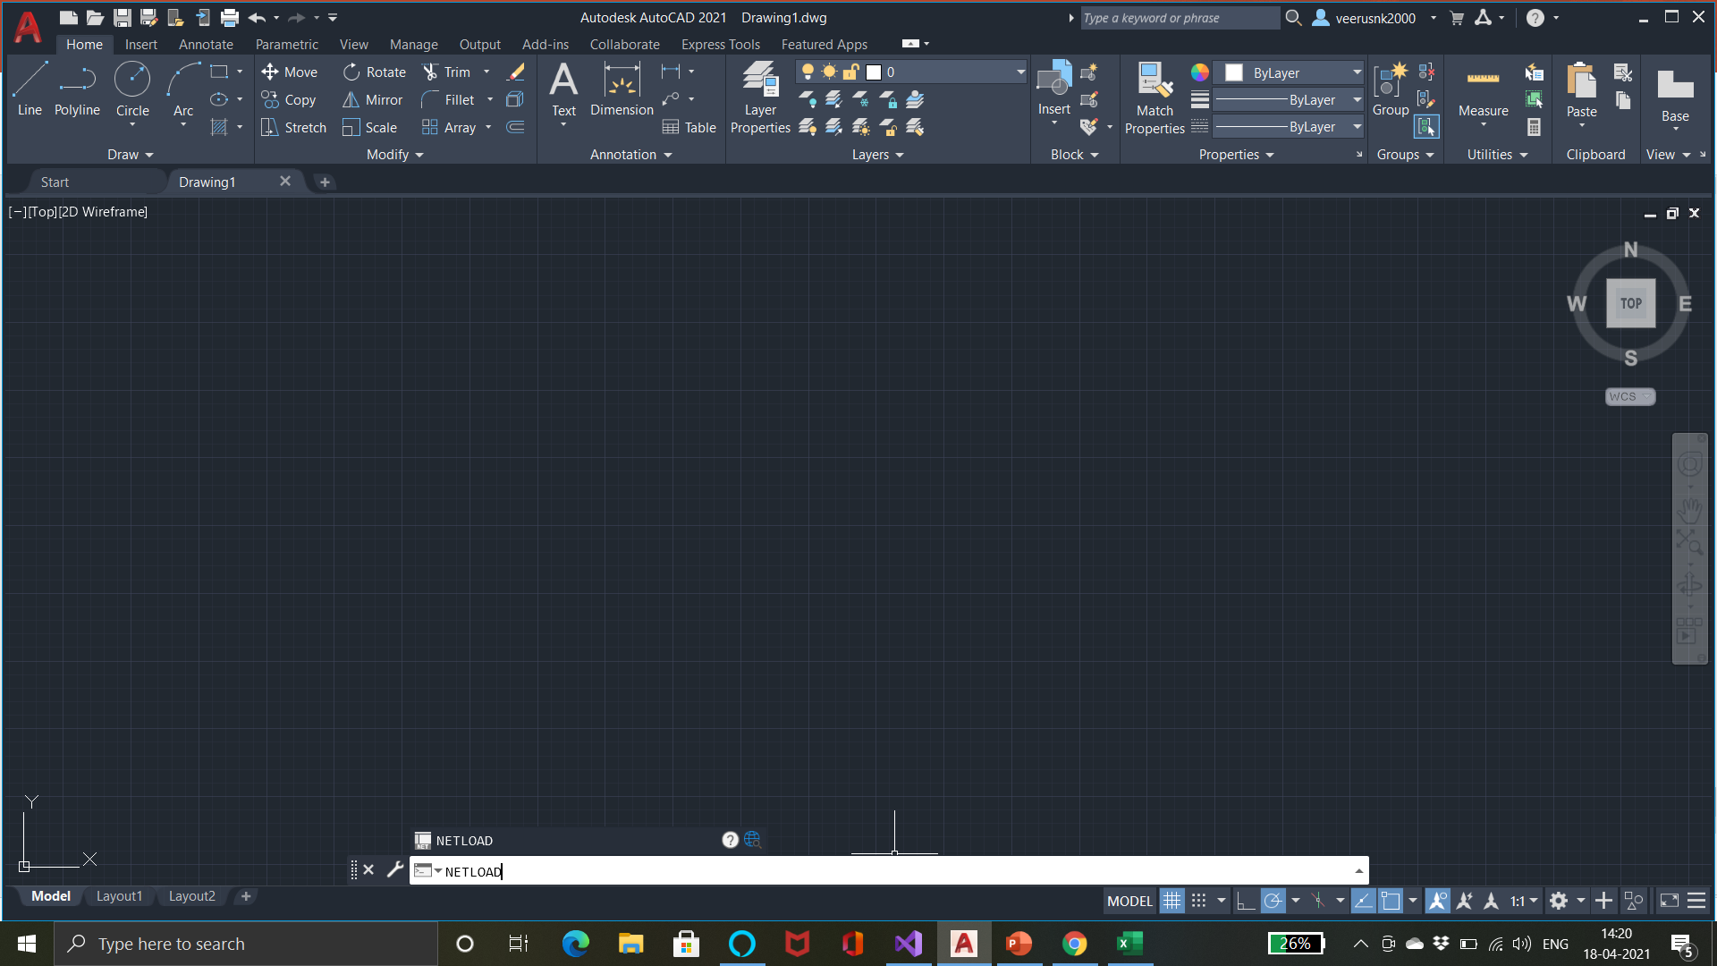
8a) The DrawSlope_click function:
A document, database is retrieved as the function is supposed to draw to AutoCAD.
The function takes input of slope parameters such as Start point, bench width, bench height and slope angle and assigns them to the global variables after converting them to appropriate type.
The coordinates of crest, toe and the end point of slope are calculated with respect to the start point and the four points are stored in a global array of points.
A transaction is started and a block table a block table record are retrieved through the transaction.
Three lines joining the adjacent points are created, appended to the block table record and added to the transaction. The transaction is then committed.
The procedure to load the .dll project file, run our “Commit” command and the output after the coding of Draw Slope button are shown given below along with the images:
Open AutoCAD drawing file and type “NETLOAD” in the Command prompt.
Browse for the .dll project file, select it and click on “Open”.
Allow the project to be loaded on AutoCAD.
Type the command name used in the project in the command prompt and click on the ‘Enter’ button.
The input form will appear before the user.
The user will have to fill the inputs and click on the “Draw Slope” button and click on the “TOP” button in AutoCAD to view the slope.
(a)

Slide 22
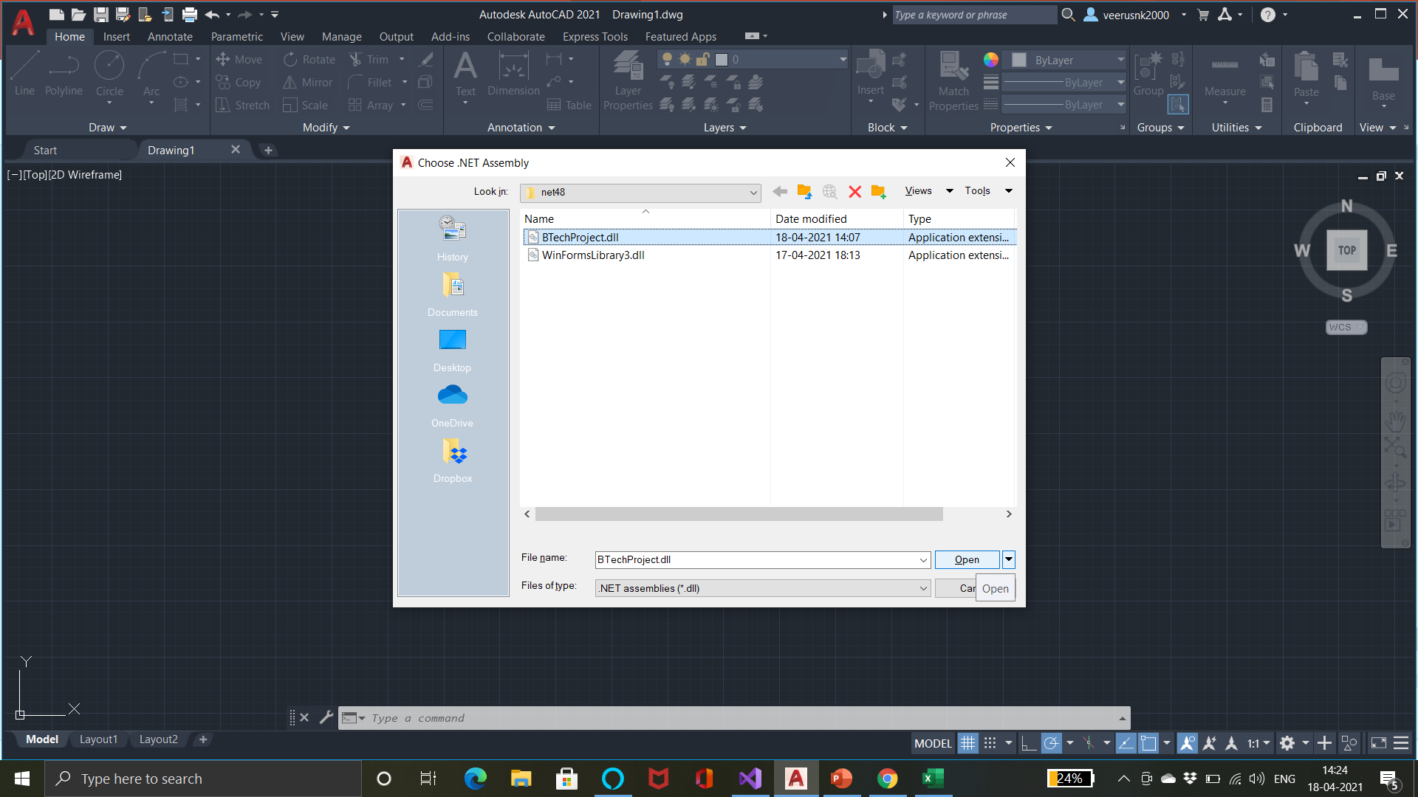
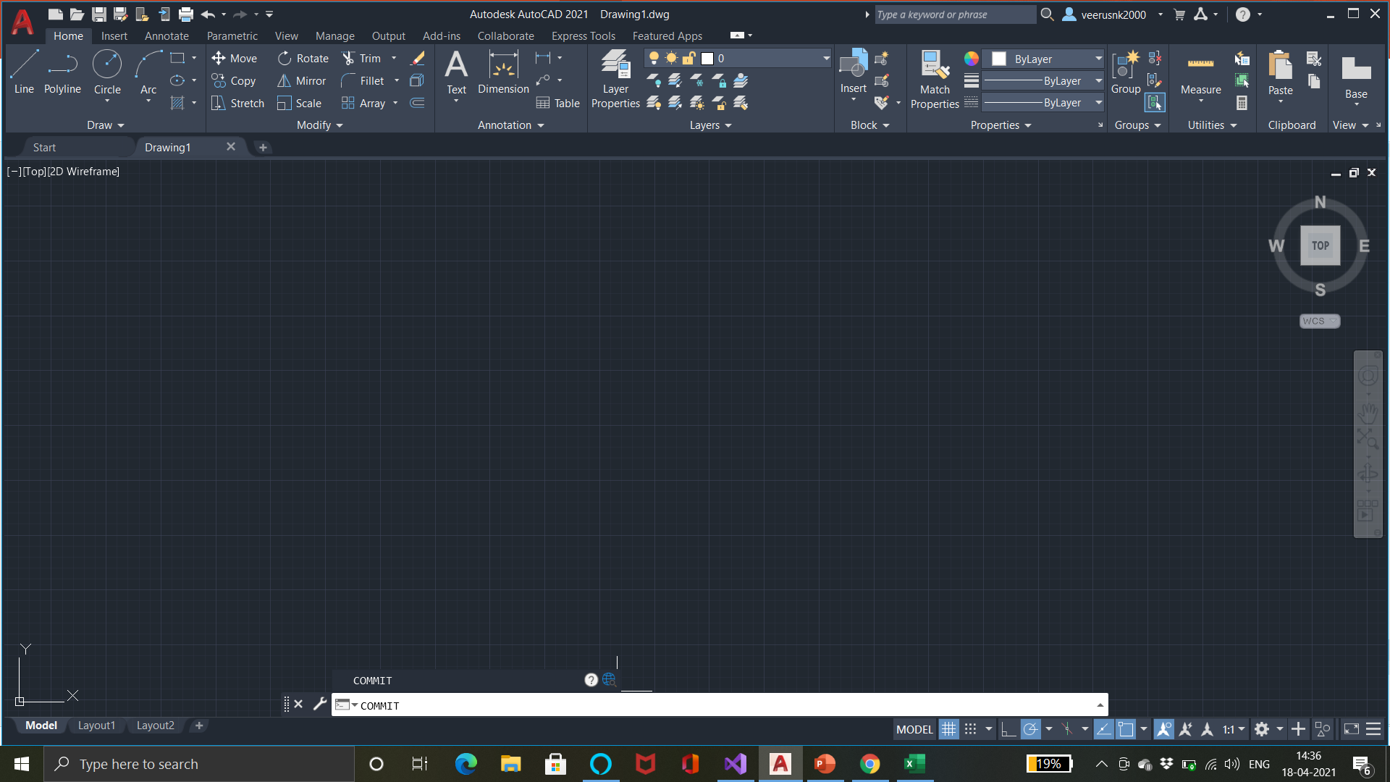
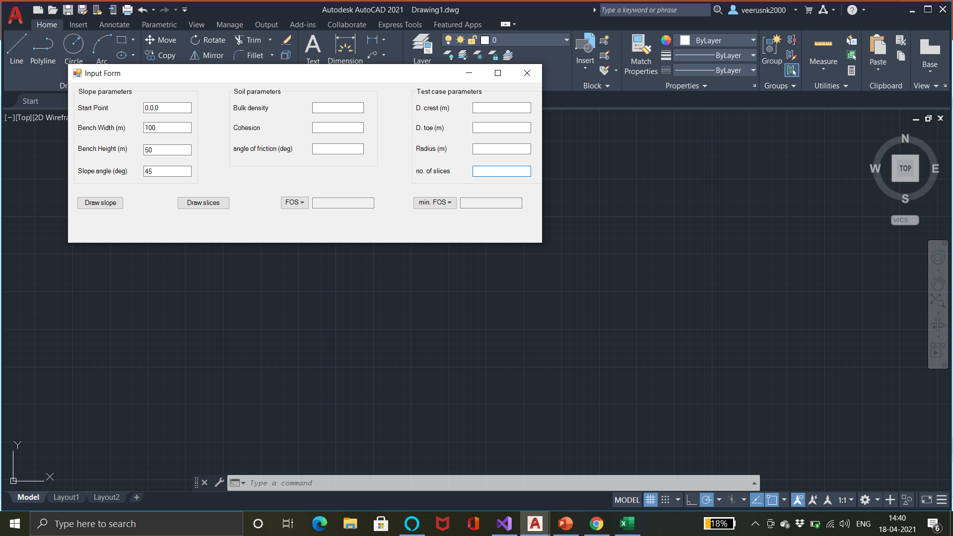
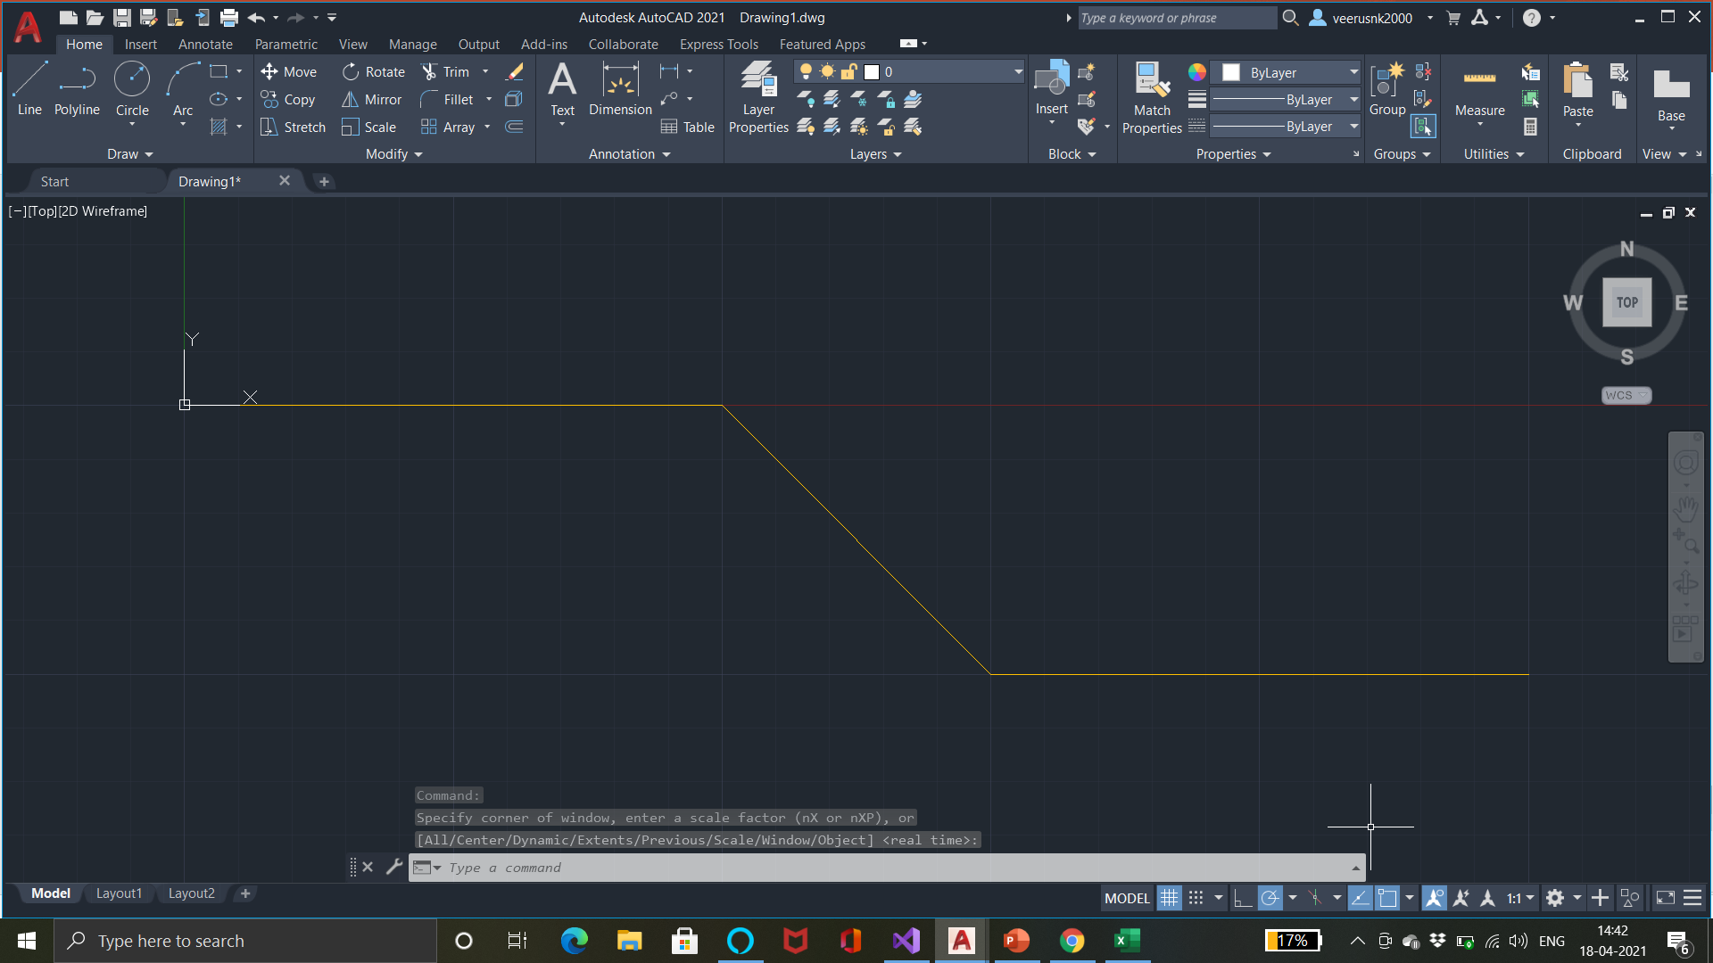
(d)
(b)
(e)
(f)
Notice that the code runs fine even when the soil and test case parameters aren’t input.
However, clicking the other three buttons won’t lead to any action since we haven’t coded for it yet.

Slide 23
8b) The DrawSlices_Click method:
Since this method is supposed to draw output (the test curve and the slices of the sliding rock mass) on AutoCAD drawing file too, we need to retrieve Document, database, start a transaction and get a block table and block table record as in the previous method. Remember to lock the document.
It will take input of the test case parameters i.e. the distances (d1, d2) of the arc points cutting the upper and lower benches from the crest and toe points respectively and the radius of the test arc (R). It’ll also convert these parameters and assign them to variables.
This method would then make a call to the Curve_data method sending d1, d2 and R as parameters.
The Curve_data method processes the data and returns the curve attributes including start angle, end angle, x, y coordinates of the center and the end point of arc. These are stored in the current method. The end point need not necessarily lie on the lower bench (to the right of the toe) as it can cut the slant portion too. So, it needs to be calculated out.
The method then makes a call to the SlicesData method sending the 1st point, the last point, the center point and the radius of the curve as parameters. The SlicesData method will return a 2d array of 3d points representing the end points’ coordinates of each boundary between the adjacent slices. It’ll also contain the 1st and the last border coordinates.
The method then creates an arc object the attributes received from the Curve_data method. This object is then appended to the block table record and added to the transaction. The method then iterates through the 2d array of points and creates a line object for each boundary between slices and append each of them to the block table record and adds them to the transaction.
The transaction is then committed.
We need separate functions to get the curve and slices data as these tasks need to be committed a large number of times while finding the curve with minimum FOS. And these functions are not coded to draw the curves and slices after calculating their data as we don’t want to display each of the curve and slices which we will check while finding the minimum FOS.

Slide 24
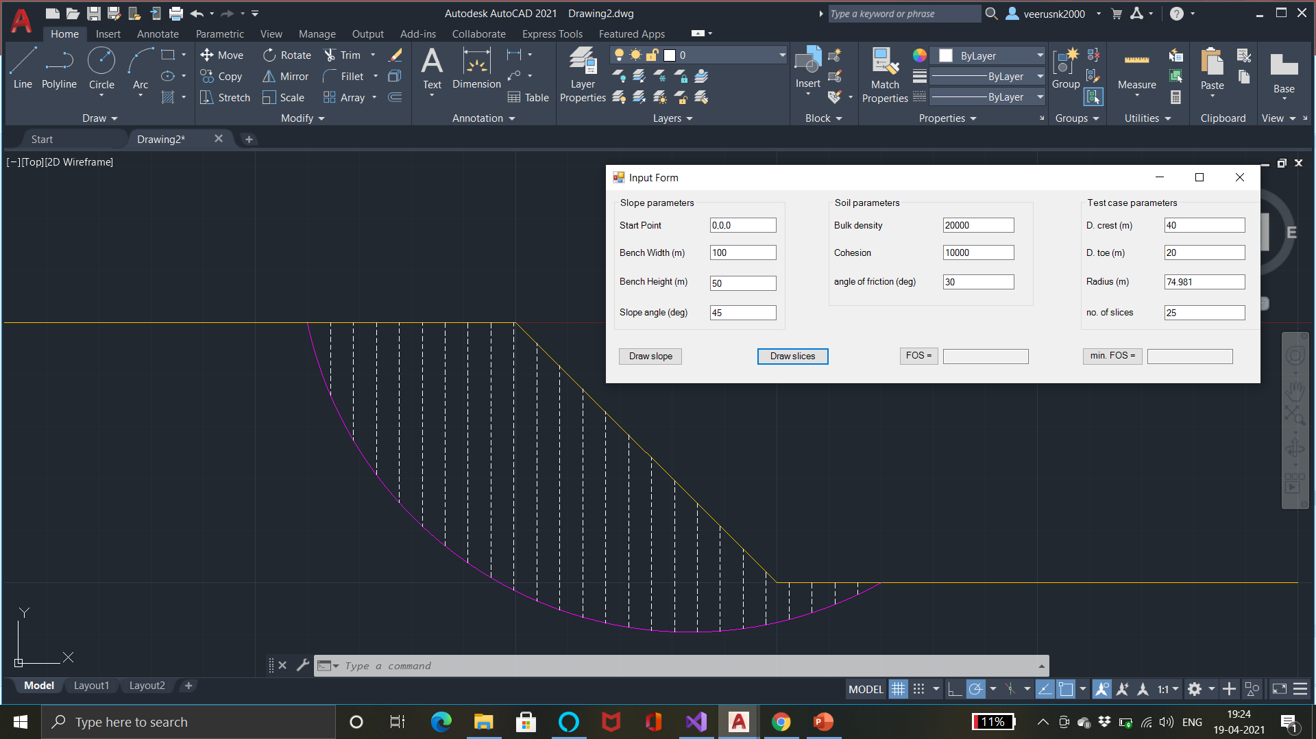
Output on clicking the Draw Slices button:

Slide 25
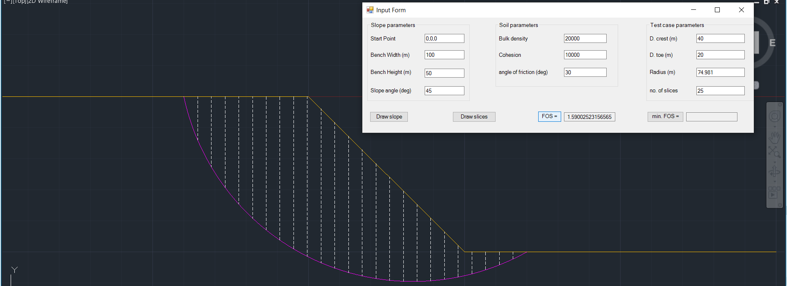
8c) The GetFOS_Click method:
This method is coded to accept the soil parameters (bulk density, cohesive strength, internal angle of friction of the soil. It’d convert these data to double type and store them as global variables.
The method will then make a call to the SolveFOS method sending the test curve slices data which would be saved globally by the DrawSlices_Click method.
It isn’t coded to calculate the FOS by itself as this process again, needs to be performed a large number of times while finding the minimum FOS by calculating FOS for a large number of curves. Further, this method is supposed to output the FOS of the test curve input by the user and we don’t want it to output the FOS of every test curve we iterate over.
The SolveFOS method returns the value of FOS of the test curve. This value is displayed in the FOS textbox which is set as read-only.
The output on clicking the Get FOS button:

Slide 26
8d) The Curve_data method:
The method takes the distances (d1, d2) of the arc points intersecting the upper and lower benches from the crest and toe resp. and the radius of the test curve.
It’s purpose is to find out the center of the circle of which the arc is a part of, the start angle of the arc (the angle which the line joining the center of the circle and the start point of the arc makes with the +ve x axis in the anticlockwise direction, the end point of the arc and the end angle of the arc. The start angle, center and the end angle are required along with the radius of the arc to draw the arc. Hence this calculation is necessary.
The coordinates of the center point are calculated as follows:
(a) Spot the mid point (M) of the two points (A, B) on the benches where the arc cuts the benches,
(b) Calculate its distance from either of the points(d3),
(c) Then calculate the distance of this point from the center (C) of the circle using Pythagoras theorem(d4),
(d) Calculate the inclination (θ₁) of the line AB with –ve x axis.
(e) Calculate the inclination of CM θ₂ = π – θ₁.
(f) The x coordinate of C = (x coordinate of M + d4 Cos θ₂) and the y coordinate = (y coordinate of M + d4 Sin θ₂)
After this, the method will check whether the arc cuts the slanting portion of the slope to find out the end point of the arc as follows:
(a) Distance of the center of the circle from the slant portion is calculated using distance formula in coordinate geometry,
(b) Coordinates of the point on the slant closest to the center of the circle (D) is calculated,
(c) Distance between this point and the lower point where the arc would cut the slanting line (P) is calculated using the Pythagoras Theorem.
(d) Coordinates of P are calculated. If the x coordinate of P is less than the x coordinate of the Toe, the end point of the arc will lie on the slant portion, else it will lie on the bench.
Start angle, End Angle of the arc are calculated using basic geometry.
The data to be returned are returned in a double type array.

Slide 27
8e) The SlicesData method:
This method takes the coordinates of the start and end points of the sliding rock mass, coordinate of the center and the radius of the test arc.
It is supposed to return a 2d array of 3d points which represent the endpoints of the boundaries between the adjacent slices. The 1st row in the array contains the upper ends of the boundaries which lie on the slope where as the 2nd row contains the lower ends of the boundaries which lie on the test curve.
The x coordinate of the 1st and last points are given as an input to the method. The x coordinates of the slice boundary points are in a AP whose 1st term is the x coordinate of 1st point and the common difference can be calculated using the x coordinates of the 1st and the last point and the number of slices which was saved as a global variable. The x coordinates of points in both the arrays will be the same.
The y coordinates of the upper boundary points are different under 3 different conditions for the x coordinates:
(a) if the x coordinate of the inter-slices boundary is lesser than the x coordinate of the crest point, the y
coordinate of the upper boundary point is equal to the y coordinate of the crest.
(b) if the x coordinate of the inter-slices boundary is greater than the x coordinate of the toe point, the y
coordinate of the boundary point is equal to the y coordinate of the toe.
(c) in the case between these two conditions, the y coordinate has to be calculated by substituting the x
coordinate of the point in the equation of the slant line.
The y coordinates of the lower boundary points can be calculated by substituting the x coordinates of the points in the equation of the circle.
These coordinates are stored in a 3d array (1 row for the x coordinates of the boundary points since the upper and lower boundary points have the same x coordinates for the vertical slices, 1 each to store the y coordinates of the upper and lower boundary points respectively).
This array is then used to create the 2d array of 3d points which would be returned to the calling method.

Slide 28
8f) The SoleFOS method:
This method takes the 2d array containing the end points of the inter-slice boundaries as input and returns the FOS along the curve. FOS is calculated using Spencer’s Limit Equilibrium method described earlier in the presentation.
5 double type arrays of sizes equal to the number of slices are declared to store weights, base angles, components of weights along and perpendicular to the bases, cohesive forces along the bases of each slice. These quantities are stored in arrays because they are used a few times during the following calculations.
F is calculated as follows, neglecting the inter-slice forces and we have neglected the pore pressure as well:
F = [Σ(c’ b Sec α + tan φ’ W Cos α)] / Σ(W Sin α)
The actual factor of safety when inter-slice forces are considered is generally in the range of F - 1.35 F
So, the initial value for iteration is set at F and we iterate up to 1.35 F with a suitable gradient. For this
purpose, we store the values of F’s form F to 1.35 F with a gradient of 0.01 in an array.
The inclinations of inter-slice forces are assumed to be equal for all slices in this method. We check the sums of resultant inter-slice forces(Q) on each slice for various values of inclinations(θ) ranging from 0 to the value of inclination of the slope in degrees keeping the gradient = 1 degree. The values for iterations of θ are stored in an array as well.
The sumQ, Qmin variables are declared and initialized with 0, 1000000000(any large number which should be larger than the values sumQ can attain).
A double array with size equal to that of the θ array is also created to store the F (fosθf) value for each θ for which the absolute sum of Q is minimum for that particular θ (force equilibrium condition).
sumQ is calculated for each value of F for each value of θ using the formula:
sumQ = Σ{[c’ b Sec α / F + tan φ’ W Cos α / F – W Sin α] / [Cos(α - θ) ( 1 + tan φ’ tan(α - θ) /F)]}
After sumQ is calculated for the rock mass for a particular F for a particular θ, it is compared with Qmin and Qmin is set to sumQ if absolute value of sumQ is lesser than Qmin and fosθf value for that θ is set to current F. sumQ is set to 0 in any case for the next iteration of F for the same θ or the next θ. Once all F values have been iterated for a particular θ, Qmin is reset to the large value it was initialized with.

Slide 29
8f) Contd.
The moment equilibrium conditions are checked similarly for those values of F stored in the array for each value of θ stored in the array and F value for which absolute value of resultant moment values are minimum for a particular θ are stored as well in an array (fosθm).
sumQm and Qmmin are declared and initialized to 0 and a large number respectively.
sumQm is calculated for each value of F for each value of θ using the formula:
sumQm = Σ{[c’ b Sec α / F + tan φ’ W Cos α / F – W Sin α] / ( 1 + tan φ’ tan(α - θ) /F)}
After sumQm is calculated for the rock mass for a particular F for a particular θ, it is compared with Qmmin and Qmmin is set to sumQm if absolute value of sumQm is lesser than Qmin and fosθf value for that θ is set to current F. sumQm is set to 0 in any case for the next iteration of F for the same θ or the next θ. Once all F values have been iterated for a particular θ, Qmmin is reset to the large value it was initialized with.
Now, the value of a new variable FOS is set to the average of 1st values in the fosθm and fosθf arrays and a variable diff is declared with value equal to the difference between the 1st values in the two arrays.
We iterate through the 2 arrays (fosθm and fosθf ) and check the difference between the corresponding elements. If the absolute value of this difference is lesser than the diff value, then the diff value is set to this difference and the value of FOS is set equal to the average of the current values in the 2 arrays.
Final value of FOS after the iteration finishes is returned to the calling function.

Slide 30
8g) The FOSmin_Click method:
This method is supposed to iterate over various test curves by varying values of d1, d2 and radius to find out the curve with the minimum FOS and draw the curve with the minimum FOS on AutoCAD. So, it is required to retrieve a document, database, initialize a transaction and retrieve a block table and a block table record.
2 arrays are created to store the different values of d1s and d2s over which we want to iterate. (This is optional). The gradient for d1 is set 4m and for d2 is 2m.
A variable Fmin can be initialized with a large number and variables to store the attributes of an arc can be declared.
We code the method to iterate over every value of d2 for each value of d1.
The initial value of radius for iteration is set at 5 greater than the radius of circle with the points at distances d1, d2 from crest and toe respectively as diametrical end points. The gradient for iteration of radius is set at 5m.
For every iteration of radius, d2 and d1, a call is first made to the Curve_data method passing d1, d2, radius as arguments to get the start angle, end angle, x, y coordinates of the current test curve.
Next call is made to the SlicesData method passing start point, end point, center and radius of current test curve as arguments to get the coordinates of the inter slice boundaries.
Finally, a call is made to the SolveFOS method passing the slices data as argument. The value of F received is compared to the Fmin value and if the value of F is lesser than the value of Fmin, Fmin is set to F and the attributes of the current test curve are stored.
After the iterations are completed, the value of Fmin is displayed in the minFOS textbox and an arc object is declared and allotted the attributes which were saved corresponding to the weakest arc. This object is then appended to the block table record and added to the transaction.
The output after clicking the min. FOS button is shown in the following slide:

Slide 31
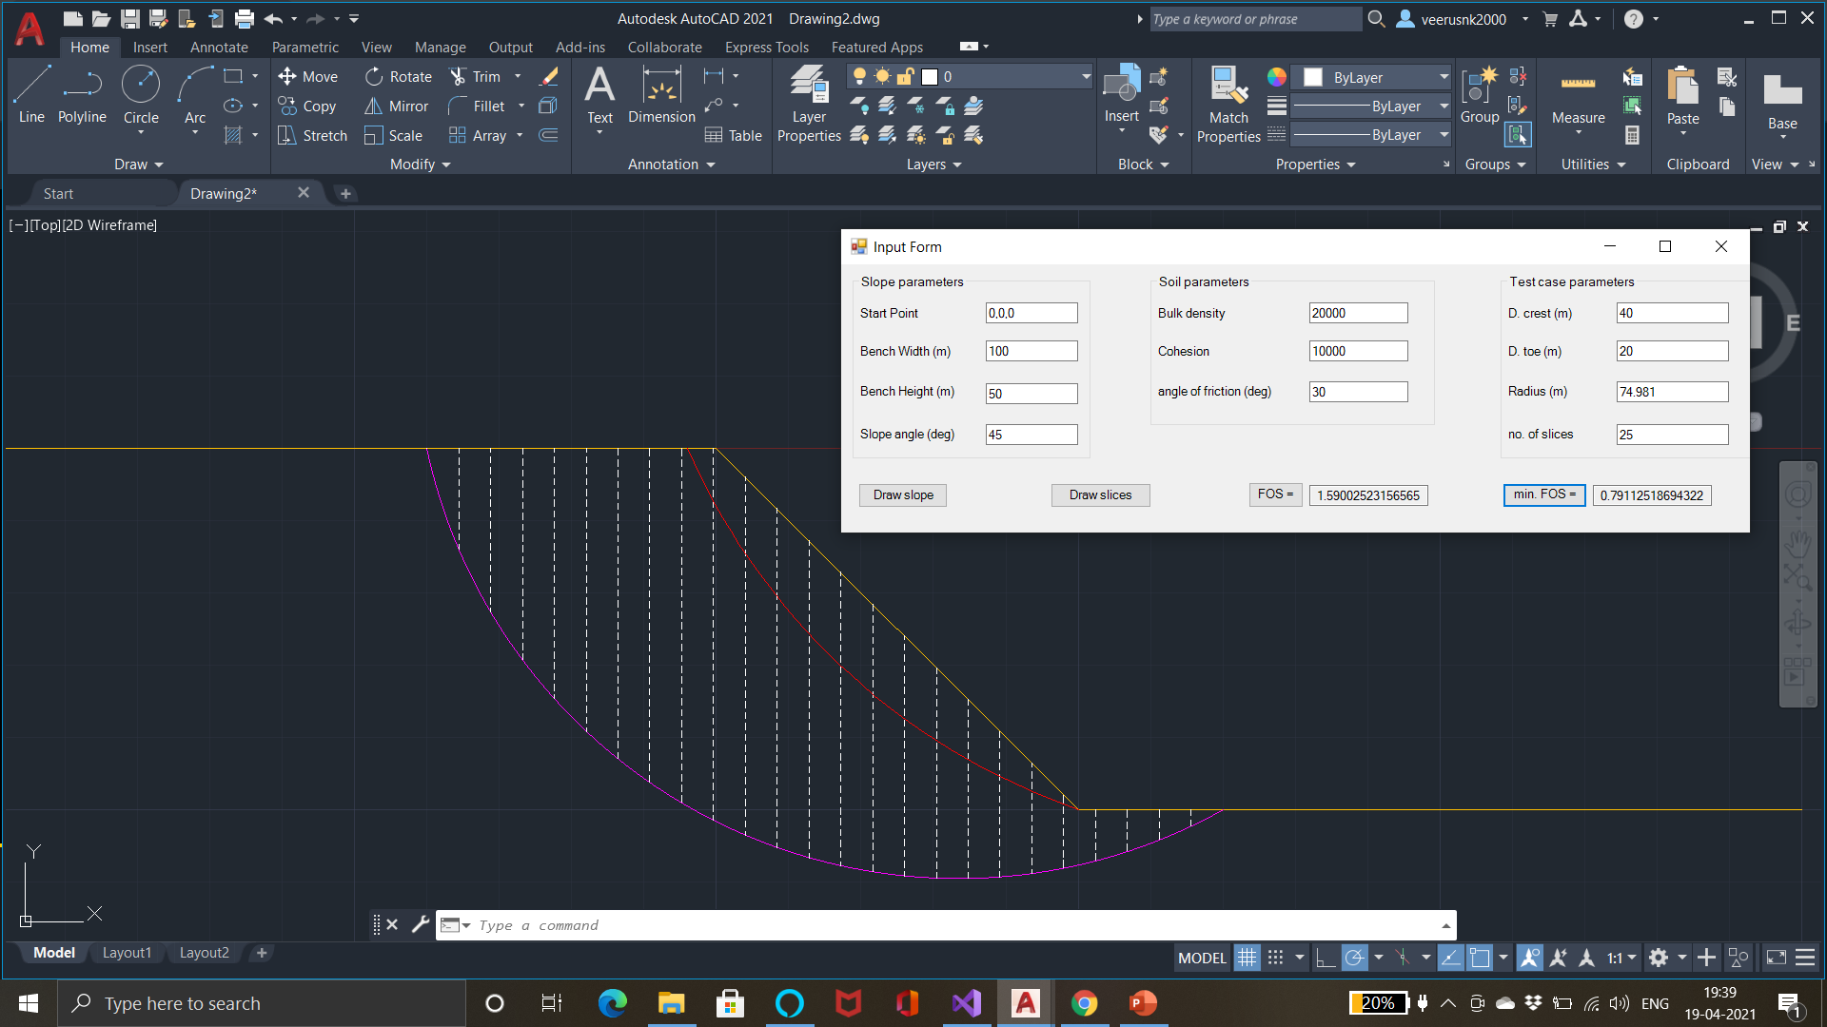
Output after clicking the min. FOS button: The red curve represents the weakest curve and its FOS is shown in the text box next to the min FOS button.

Slide 32
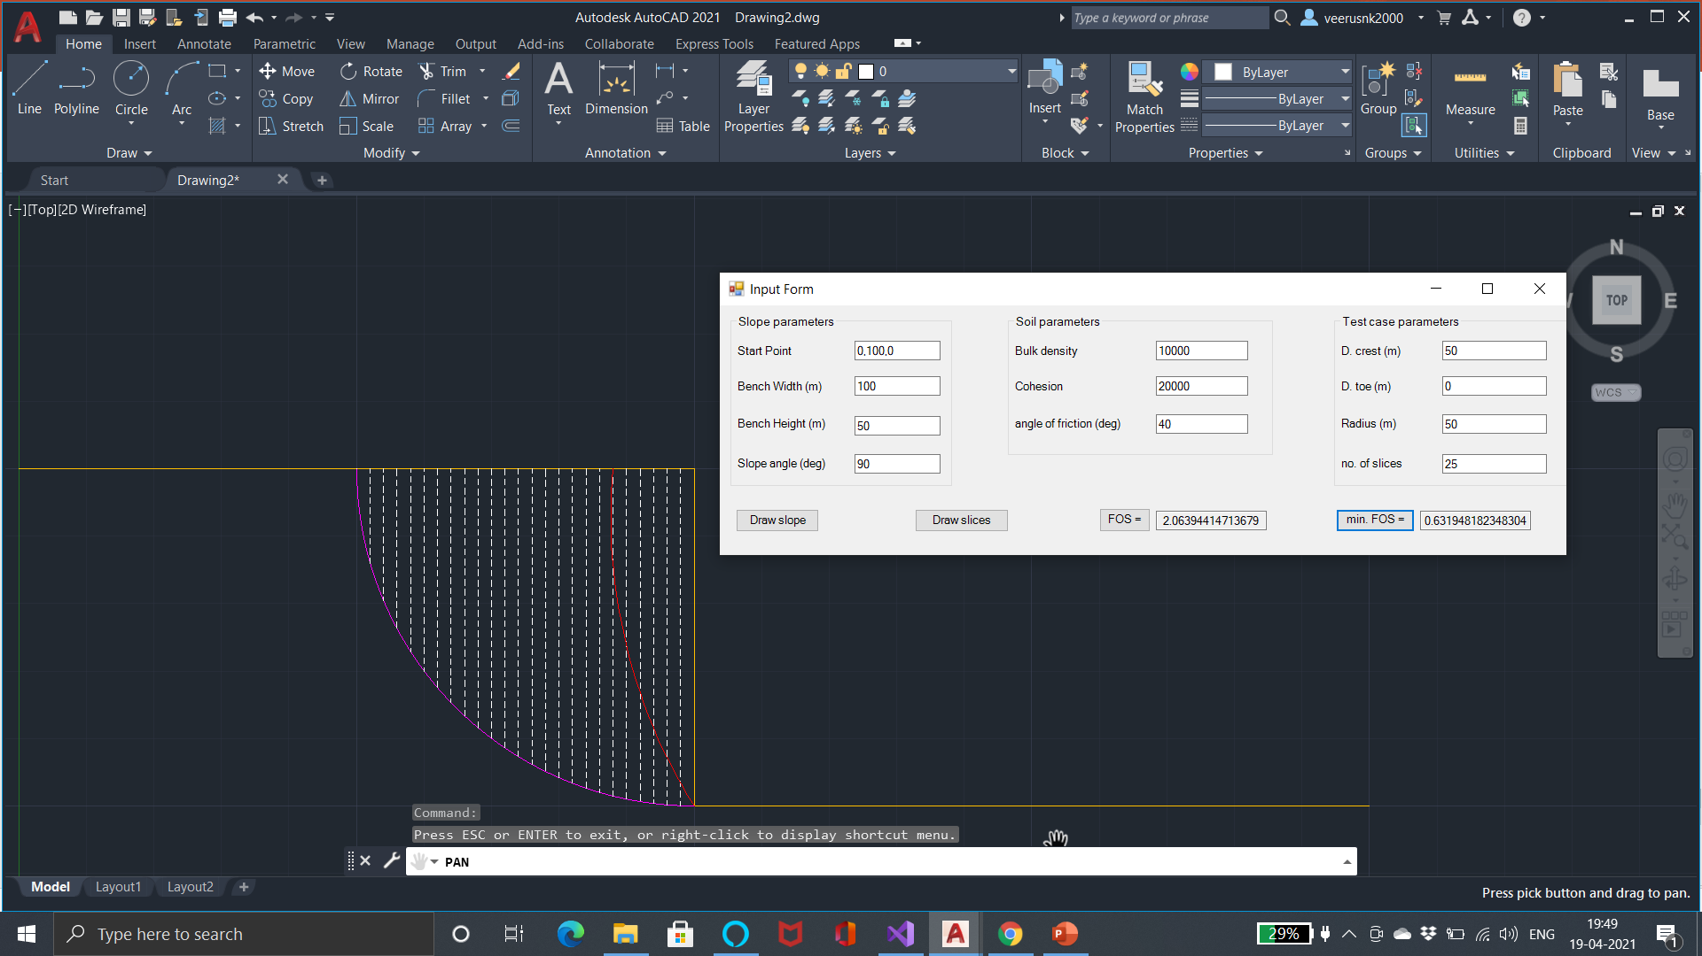
9) Example Images: Input form and the output file on AutoCAD are attached for 4 test cases.
Case 1:

Slide 33
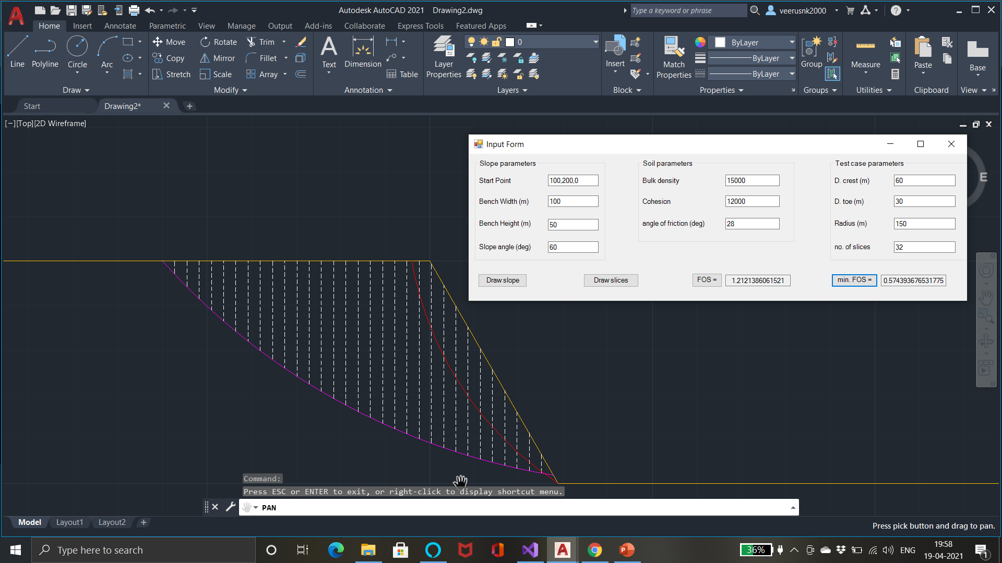
Case 2:

Slide 34
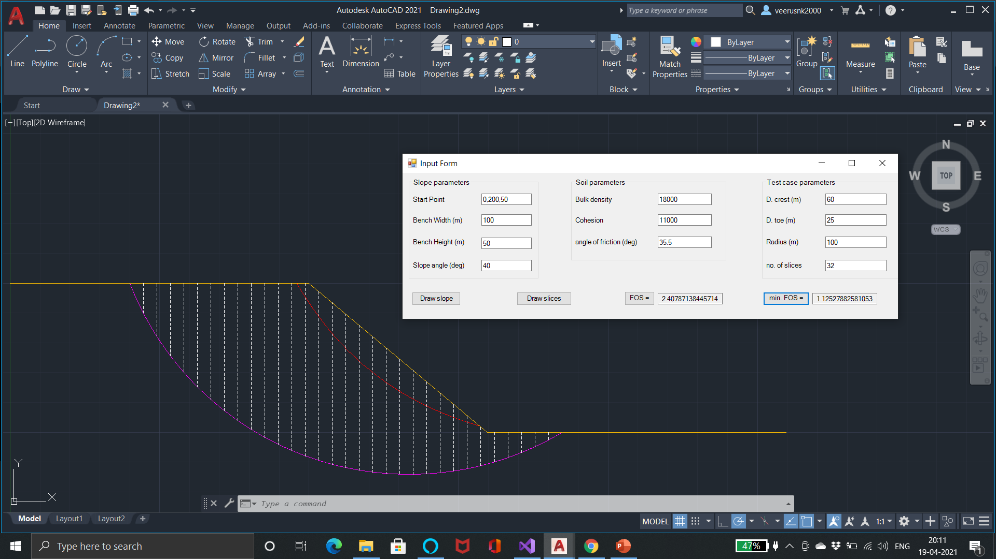
Case 3:

Slide 35
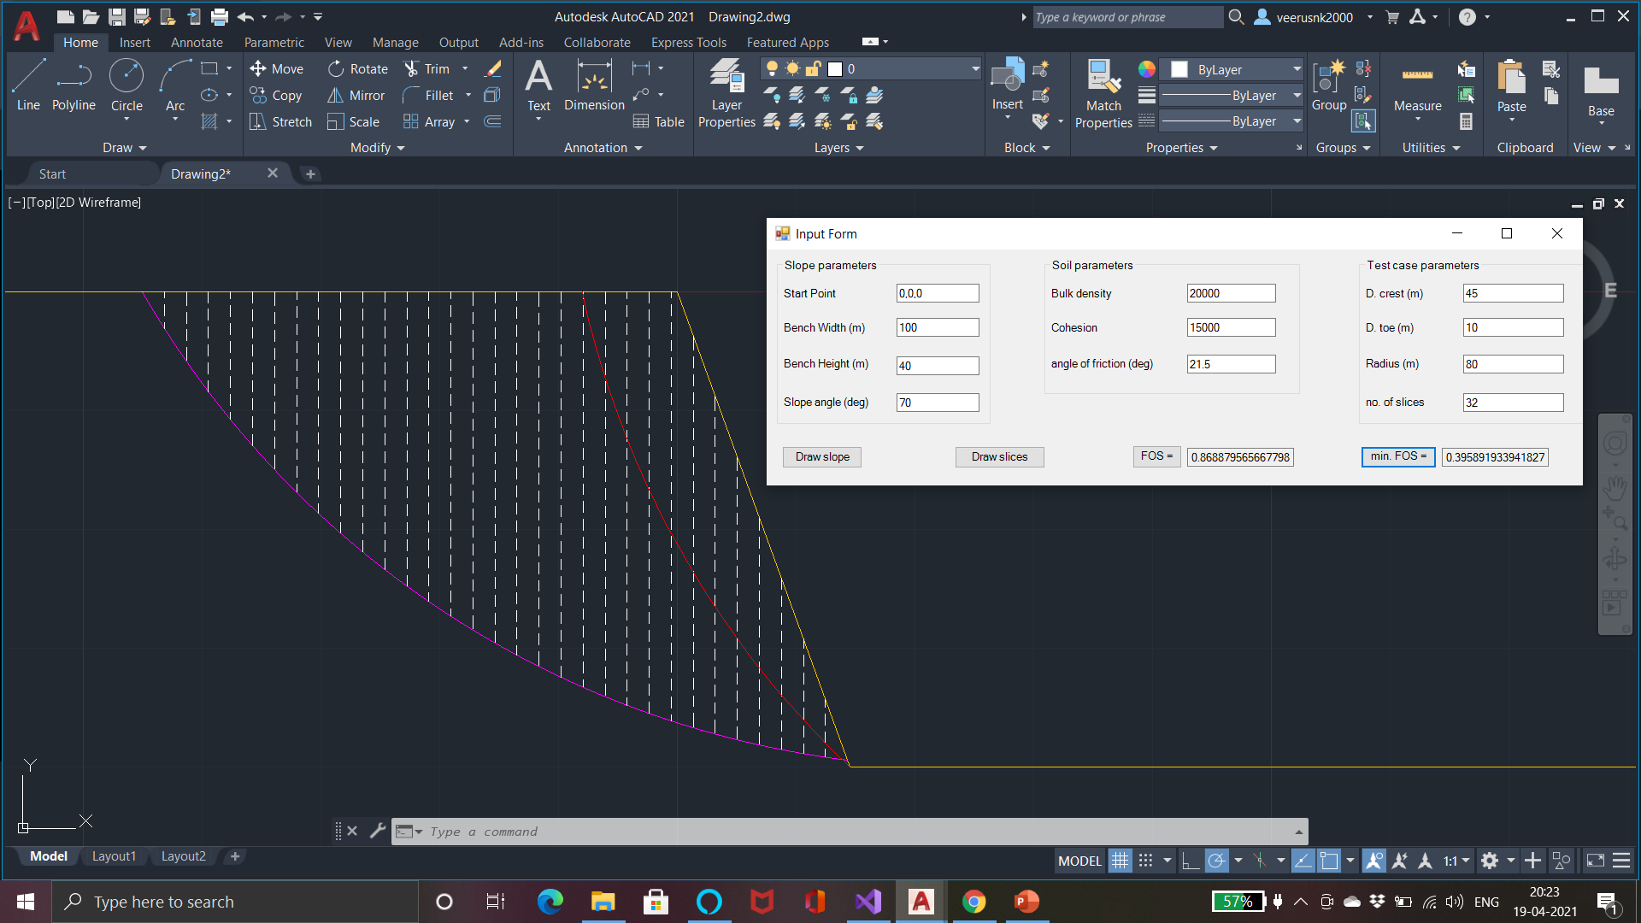
Case 4:

Slide 36
10) Improvisations and optimization:
The pore pressure, external forces and the non homogeneity of the soil can be taken into consideration and the code can be improvised for the same purpose.
More number of cases can be taken into consideration to increase the accuracy of calculation in reasonable time by the use of “Threading”.
The use of ML can help the computer to gain experience and decide by itself what gradients to set for the iterations and avoid unnecessary iterations and hence optimising the program.

Slide 37
11) Summary:
Code for executing Spencer’s Limit Equilibrium method for slope stability analysis has been successfully developed using C# .NET application on visual studio.
The main advantage of this plug in is that it is very cost effective and can be used for teaching and learning purpose and because student version of AutoCAD software is easily available on the AutoDesk website free of cost and is widely popular. Visual Studio Community is also available free of cost for the Windows and mac users.
This application calculates the values of FOS quite accurately and hence can be used on a moderate scale.
The application is user friendly. They can install the .dll project file just once on AutoCAD to activate the plug-in and use the single form to verify any number of cases changing the start point.
It iterates through a large number of cases and hence considers a vast range of scenarios and hence is quite dependable.
Thank You!

